Slide 1


Lecture 2-2 Workflow-Based Software Development Concepts
CSE446 / CSE598 Software Integration and Engineering
Unit 2 Software Development by Composition and Integration
Dr. Yinong Chen

Slide 2
Unit 2 Outline
Software Development by Composition and Integration
2-1
2-2
2-3
Enterprise Architecture and Business Process
Workflow Foundation 1: Concepts
Workflow Foundation 2: Case Study
BPEL (Business Process Execution Language)
WSDL in BPEL
BPEL constructs and BPEL Process Definition
A Case Study of BPEL Application
Stateful Services
Development Frameworks Supporting BPEL
Oracle SOA Suite and BizTalk
2-4
Unit Test 2
2-5
2-6
Message-Based Integration
Web Caching and Recommendation
2-7
2-8

Slide 3
Lecture 2-2 Outline
Previous lecture focused on the architecture design and management
Workflow for Architecture and Process Integration
Cover the Gap between Architecture (CSE360) and Development (Programming Courses)
Key Ideas of Workflow-based Application Development
Workflow Foundation Constructs and Activities
Creating WF Workflow Application
Creating WF Workflow Service
Event-Driven Approach and State Machine in WF
Assignment 2 Part 1
Project 2 Assignment 3

Slide 4
What is Workflow?
Workflow is a new solution to an old problem: Integrating, managing, and supporting business process.
Workflow offers a new model for the division of labor between people and computer:
People do only those that computers cannot: What we want.
Workflow better matches the business logic that customers require, and thus the customers can better understand the solution offered by the software engineers / architects.
Workflow better separates the tasks of software architects and programmers.
Service-Oriented Architecture makes workflow easier.

Slide 5

Kepler Project
https://kepler-project.org/
Operate on data stored in a variety of formats, locally and over the internet;
Integrating disparate software components, such as merging scripts with compiled code;
Facilitating remote, distributed execution of models.
Select and then connect relavent analytical components and data sources to create a "scientific workflow“ — an executable representation of the steps required for generating results;
Share and reuse data, workflows, and compo­nents developed by the community to address common needs.

Slide 6
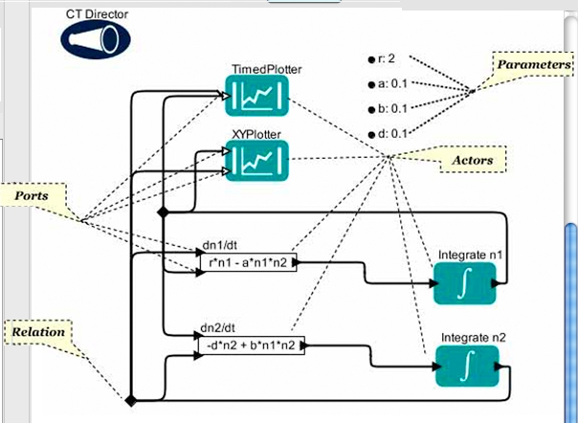
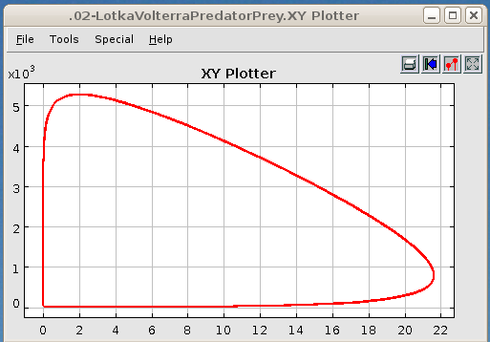
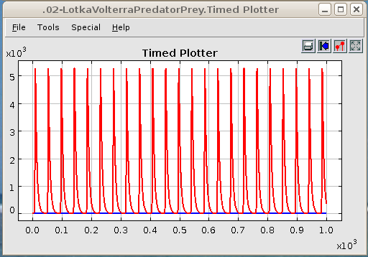
Kepler Workflow System
http://edutechwiki.unige.ch/en/Kepler_workflow_system
Director
Kepler Workflow Style
Directors (define computing and communication models)
Actors
Ports
Attributes
Relations
Example: Integration of a template, a data set

Slide 7
Traditional Software Development
Architecture Design
Flowchart / Process
Coding / Debugging
Testing / Verification
Deployment / Maintenance
Software Architects
Software Engineers
Programmers
Testers
After Sale Supporters

Slide 8
Architecture and Process Integration
Application Builders
Integration Tools
Kepler
BPEL
Workflow Foundation
For integration
For creating services
Architecture Design
Flowchart / Process
Component / Service
Repository
Why do we need this?
Service Providers
Service Providers
Service Providers

Slide 9
Why Do We Need Workflow for Coding?
Adding a layer of abstraction (graphical approach) to make application development faster and easier.
It makes the application’s main logic more visible.
By providing a straightforward picture of what is going on, the architect can help developers more quickly to understand an application’s structure.
This can be especially helpful for the people who must maintain the deployed applications, since learning a new application well enough to change it can be a time-consuming process.
Allows traditional programming style to seamlessly integrate with workflow

Slide 10
From Tiered Architecture Perspectives
Presentation
Layer (GUI)
Presentation
Layer (GUI)
Application
Processing Layer,
with Low-Level Code
Workflow Layer
with High-Level
Composition
Service and
Component Layer
Service and
Component Layer
WF Activities with
Low-Level Code
Data Management
Layer
Data Management
Layer

Slide 11

Example: How Do I Write Code to Send a Mail/Message to a Client in My Web Application?
MService.ServiceClient TestSvcProxy = new MService.ServiceClient();
string EmailAddress = "account@gmail.com";
string Password = "password";
MService.CARRIER PROVIDER = MService.CARRIER.NAME;
string address, Message;
System.Console.Write("Please enter an address: ");
Address = System.Console.ReadLine();
System.Console.Write("Please enter the service provider: ");
System.Console.ReadLine();
System.Console.WriteLine("\nPlease enter a message: ");
Message = System.Console.ReadLine();
bool Result = TestSvcProxy.SMS(EmailAddress, Password, address, PROVIDER, Message);
if (Result)
System.Console.WriteLine("\n\nMessage has been sent.");
Mail Service

Slide 12
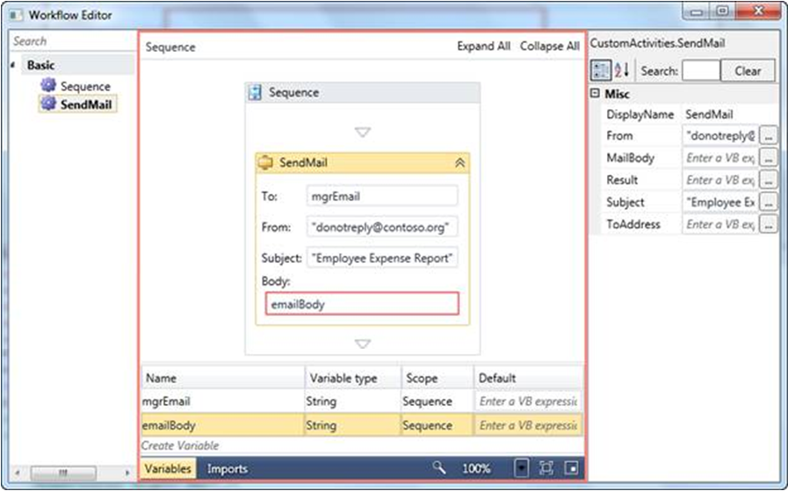
Example: Drag and Drop Designer in WF
http://msdn.microsoft.com/en-us/library/ee342461.aspx
Define parameter types
Configure your service

Slide 13
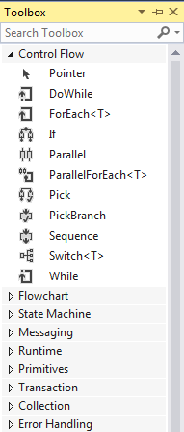
WF Built-in Activities: Control Flow (1)
http://msdn.microsoft.com/en-us/library/dd647759.aspx
DoWhile: executes an activity, then checks a condition, and repeats until the condition is false.
ForEach: executes an activity for each object in a collection.
If: creates a branch of execution.
Parallel: forks multiple activities.
ParallelForEach: Enumerates the elements of a collection and executes an embedded statement for each element of the collection in parallel.
Pick: allows waiting for a set of PickBranch events, then executing only the activity associated with the first event to occur; event-driven programming!
PickBranch: a member of Pick activity.

Slide 14
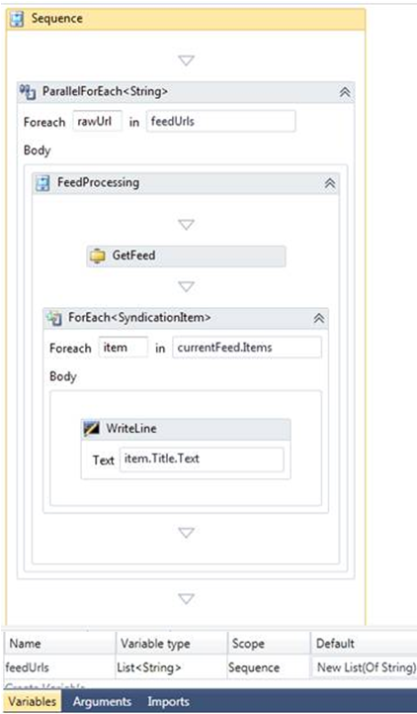
ParallelForEach and ForEach
http://msdn.microsoft.com/en-us/library/ee342461.aspx
Example: Call many URLs in parallel:
Take a list of URLs and asynchronously get all RSS feeds using Foreach <URL>.
After the feed is returned, the Foreach<item> is used to iterate over the feed items and process them.

Slide 15
WF Built-in Activities: Control Flow (2)
Sequence: groups together a set of activities that are executed sequentially. Sequence is also useful inside workflows. For example, a While activity can contain only one other activity. If that activity is a Sequence, a developer can execute an arbitrary number of activities within the while loop.
Switch: provides a multi-way branch of execution.
While: executes a single activity as long as a condition as true.

Slide 16
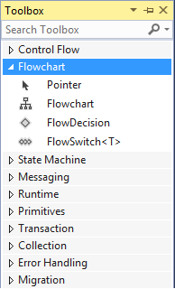
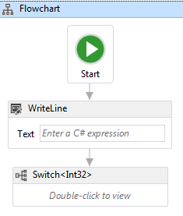
WF Built-in Activities: Flowchart (3)
Flowchart: groups together a set of activities that are executed sequentially, but also allows control to return to an earlier step. It creates a local component, similar to CodeActivity’s role.
FlowDecision: Branches execution based on a Boolean condition, similar to If, but applied at the flowchart level.
FlowSwitch: Branches execution based on an exclusive switch, similar to Switch in C#, but applied at the flowchart level.

Slide 17
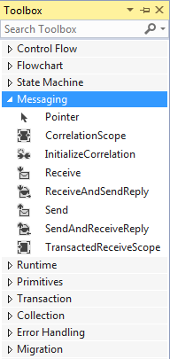
WF Built-in Activities: Messaging (4)
http://msdn.microsoft.com/en-us/library/dd487617.aspx
CorrelationScope: Provides implicit CorrelationHandle for child messaging activities. The CorrelationHandle is only visible to child activities, which associates activities together in a correlation by representing a particular shared InstanceKey or transient context in the workflow. Used for asynchronous communication.
Receive: An activity that receives a message via WCF service.
ReceiveAndSendReply: Creates a sequence of two communications.
Send: An activity that sends a message via WCF.
SendAndReceiveReply: Creates an asynchronous communication sequence.

Slide 18
Creating Asynchronous Service in WF
SendAndReceiveReply: is a template used for creating a pair of pre-configured Send and ReceiveReply activities within a Sequence activity
Send and Receive are correlated as part of an asynchronous request/response message exchange pattern on the client. SendAndReceiveReply also
Configures the OperationName, ServiceContractName properties of the Send activity.
Binds the Request property of the ReceiveReply activity to the Send activity.
Creates a CorrelationHandle as a variable in the parent activity.

Slide 19
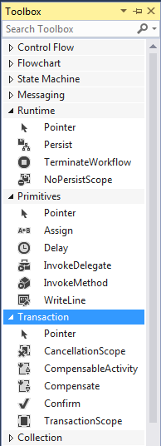
WF Built-in Activities (5)
Persist: explicitly requests the WF runtime to persist the workflow, to allow a workflow to be re-loaded later on the machine or even on another machine other, if necessary. Save all states.
Assign: assigns a value to a variable in the workflow.
InvokeMethod: Invokes a method on the object, synchronously or asynchronously.
Compensate: An activity used to explicitly invoke the compensation handler of a CompensableActivity. It provides a way of handling a problem that occurs in a long-running transaction.
TransactionScope: Makes a code block transactional. This class cannot be inherited.

Slide 20
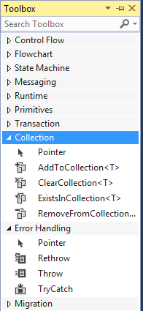
WF Built-in Activities (6)
AddToCollection, ClearCollection, ExistInCollection, RemoveFromCollection: allow to add, remove, clear, and check membership of a collection.
Rethrow: throws a previously thrown exception from within a Catch activity.
Throw: raises an exception.
TryCatch: allows creating a try/catch block to handle exceptions. In the block, it contains workflow elements to be executed by the workflow runtime within an exception handling block.

Slide 21
WF Custom Activities
The developer can wrap any block of C#, VB, and WF code into a custom activity (local component) to integrate into the workflow;
Custom activities can be simple, performing just one task, or they can be composite activities containing arbitrarily complex logic;
A business application created using WF might implement application-specific logic as an activity;
A software vendor using WF might provide a set of custom activities to make its customers’ lives easier.

Slide 22
Custom Activity Class Hierarchy
http://msdn.microsoft.com/en-us/library/ee342461.aspx
Collection of generic activities
Activity
AsyncCodeActivity
CodeActivity
NativeActivity
Activity<TResult>
AsyncCodeActivity<T>
CodeActivity<T>
NativeActivity<T>
Activity – can compose of other activities.
AsyncCodeActivity – used when your activity perform work asynchronously.
CodeActivity – Creating a local component when you need to write code to do the job.
NativeActivity –when your activity needs access to the runtime internals, for example to schedule other activities or create bookmarks.

Slide 23
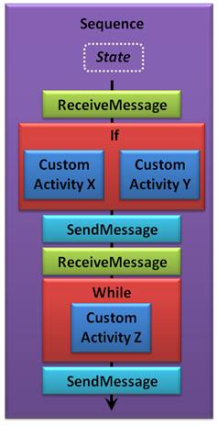
A Typical Workflow of Client Service
http://msdn.microsoft.com/en-us/library/dd851337.aspx

Slide 24
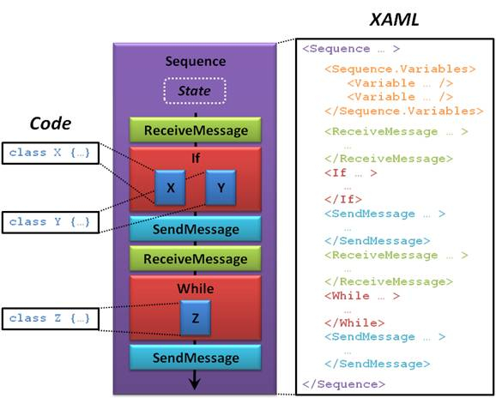
WF Designer, Markup and Code Behind
Design view
Code behind design
Markup view in XAML

Slide 25
Creating a Workflow Service
Building business logic as a service often makes sense, for example, when the same set of operations must be accessed from a
Console application
Windows forms application;
Website application.
Implementing this logic as a service consisting of a set of operations can make these applications to interoperate with the operations;
WCF interface can be used for creating SOAP and REST interface for WF service.

Slide 26
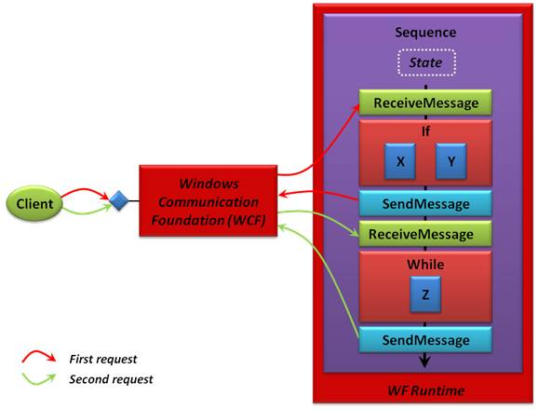
WF Using WCF for Creating Services
How do I create a RESTful Service?
Use WF to process the request for client
Convert the .svc service to RESTful service!
A
B
C
Asynchronous communication
Use WCF to create the .svc service interface for the client.

Slide 27
Hosting WF Service
Similar to WCF, WF services can be hosted in different ways:
Self-hosting
IIS hosting: running a thread of a worker process
“Dublin” hosting
“Dublin” hosting is based on IIS with extensions for additional support:
Persistence management: Saving the process (code and states for later access) and waiting for the second part of service call persistently;
Tracking and monitoring
Other utility services

Slide 28
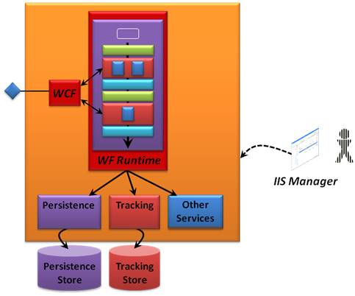
Hosting WF Service with Dublin
IIS provide basic hosting service
Dublin is the code name for extended IIS and WAS (Website Administration Services) for WF service hosting
The primary goal of “Dublin” is to make IIS and WAS more attractive as a host for workflow services.
Persistence
Tracking
Dublin extensions

Slide 29
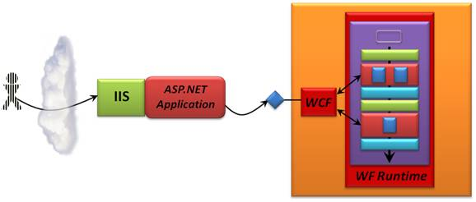
ASP .Net GUI for WF Services
GUI
Why do we use WF service behind ASP .Net? We could use code behind ASP .Net page to implement the functionality.
Tier design: separating presentation layer from application logic layer;
WF can manage states and asynchronous communication easier than ASP .Net
With parallel construct and parallel threading, WF is easier for implementing parallel computing.

Slide 30
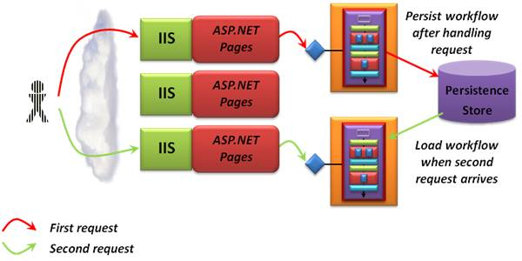
Concurrent Objects for WF Services
Multiple instances can be created for a single client’s multiple requests

Slide 31
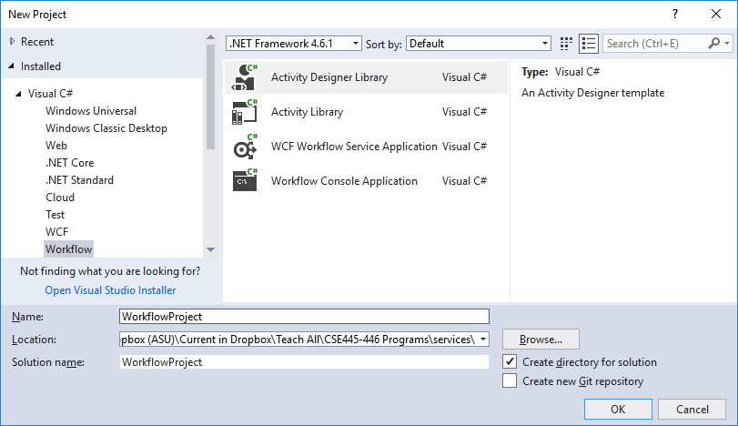
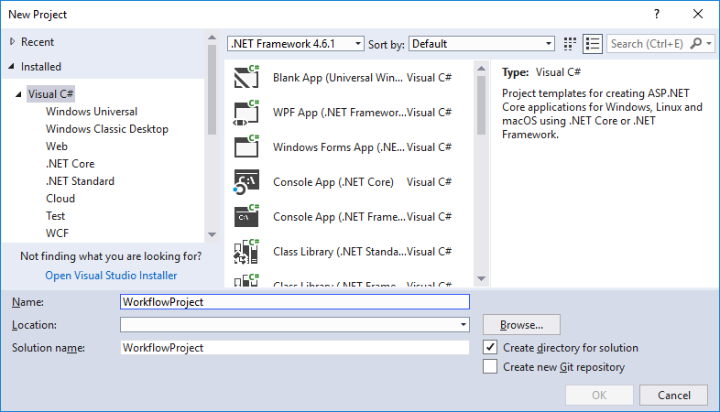
Getting Started With WF Development
In VS 2017, if you do not see Workflow template, choose Open → Project, and open an existing Workflow project.
Workflow template will be added

Slide 32
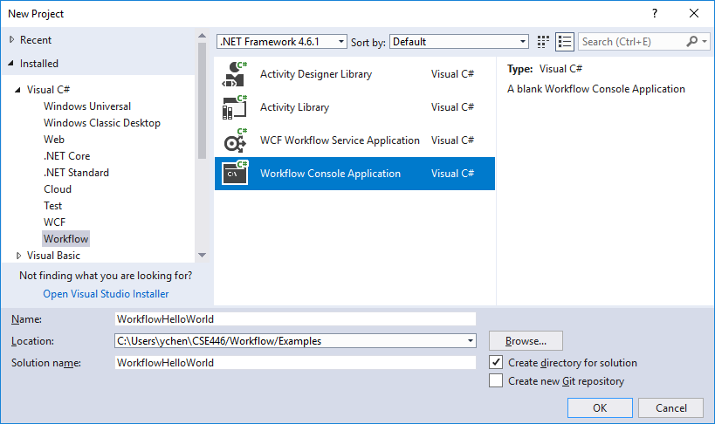
Getting Started With WF Development
In VS, File → New → Project …

Slide 33
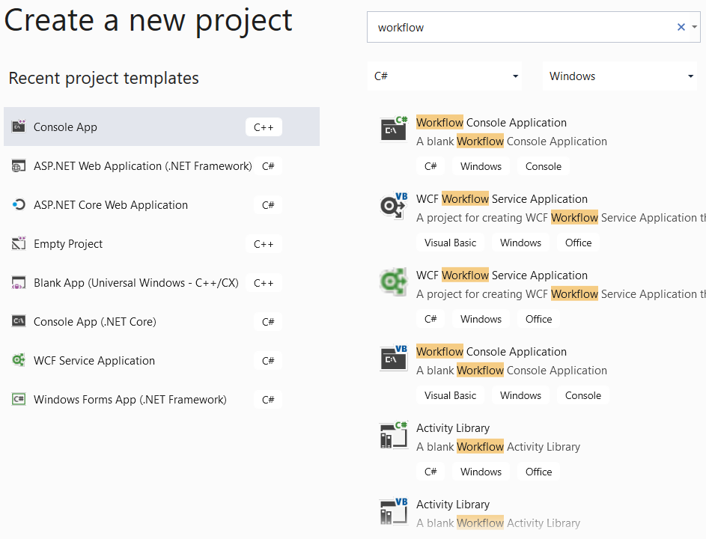
Getting Started With WF Visual Studio 2019

Slide 34
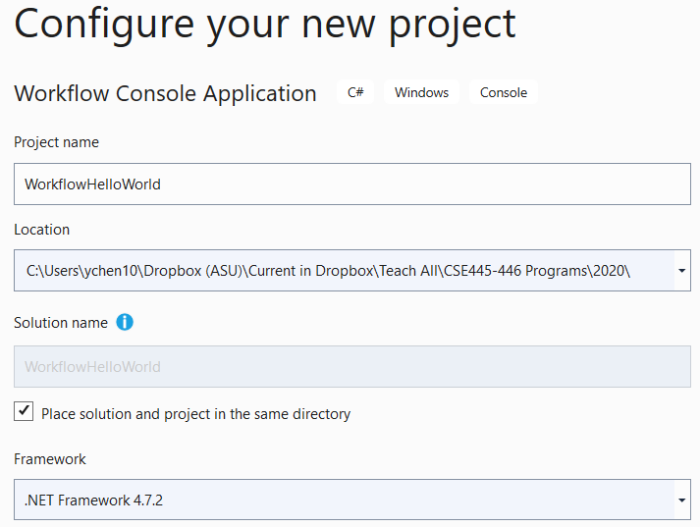
Choose Project Name and Location

Slide 35
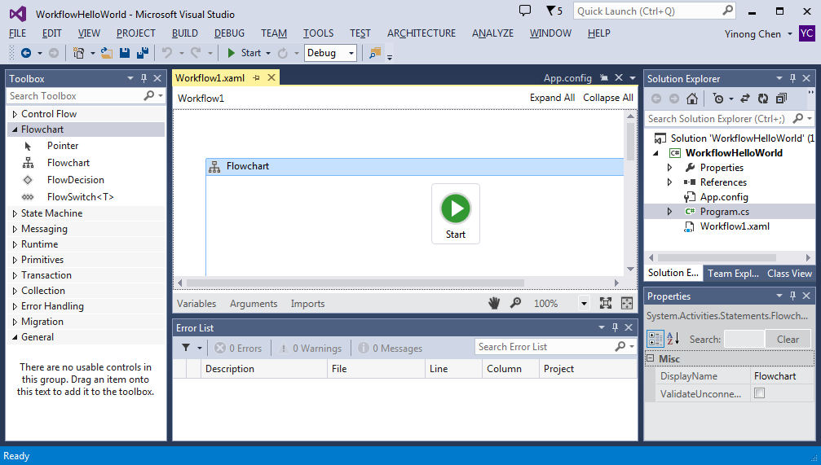
Adding a Flowchart Item into Workflow
Add Flowchart into the Workflow
Right click project name “WorkflowHelloWorld” and Choose “Add New Item”

Slide 36
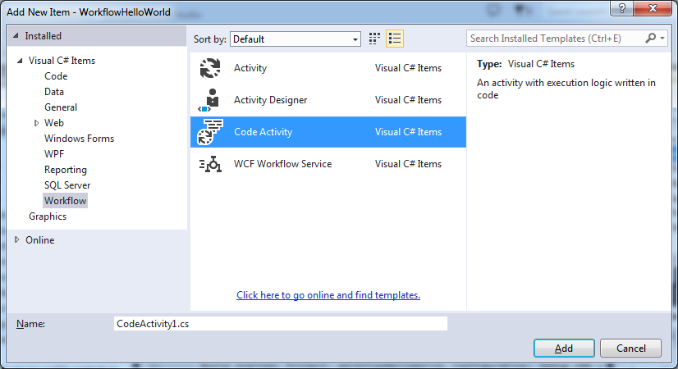
Adding a Flowchart Item into Workflow
Right click project name “WorkflowHelloWorld” and Choose “Add New Item”
Choose CodeActivity and Add

Slide 37
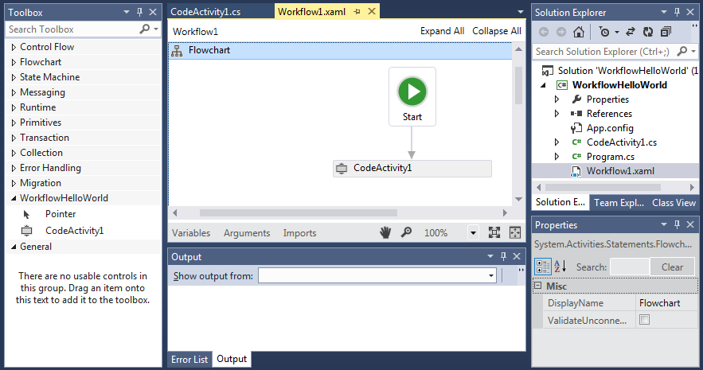
Creating a Workflow
CodeActivity1 is added into the project
Build the project, the WorkflowHelloWorld project is added into the Toolbox
Drag CodeActivity1 from Toolbox into the workflow
Project added into Toolbox
Drag and drop the item

Slide 38
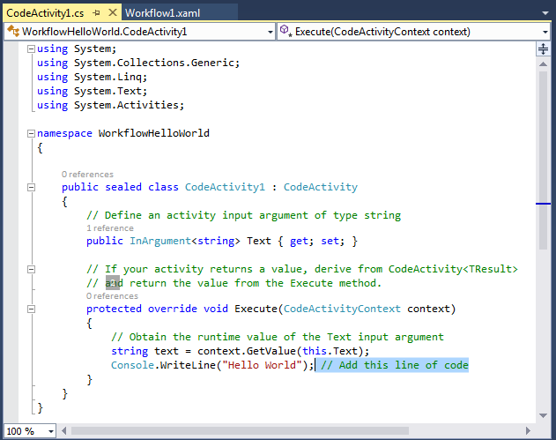
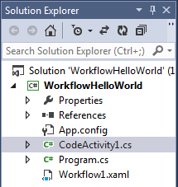
Code Behind the CodeActivity1

Slide 39
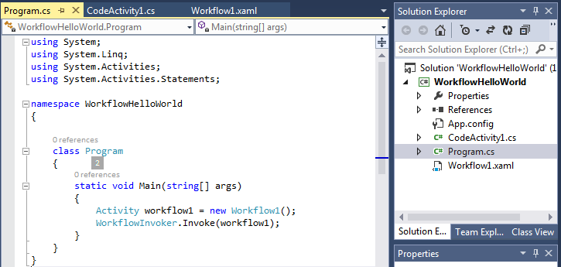
Code Behind the Main Program

Slide 40
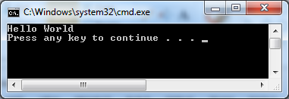
Executing the Code

Slide 41
Workflow: Support Control Flow and Data Flow
Control flow model: Assuming one processor will process the entire program, and thus, the code are organized in a sequence;
It is possible to use multithreading programming to perform parallel computing, but not easy.
Data flow model: Assuming multiple processors will process different part of the program. A piece of code will be executed when the input data is ready.
Workflow supports multiple computing models
Sequence construct
Parallel construct
Finite State Machine Model

Slide 42
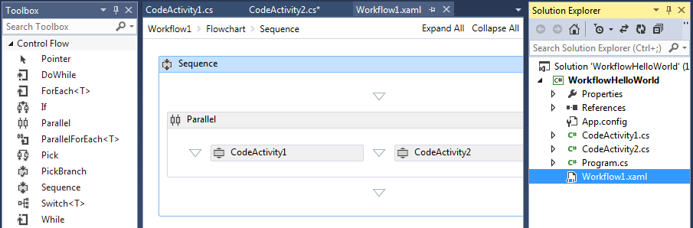

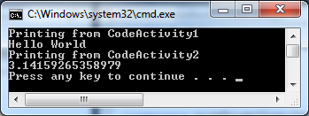
Adding Constructs for Parallel Computing

Slide 43
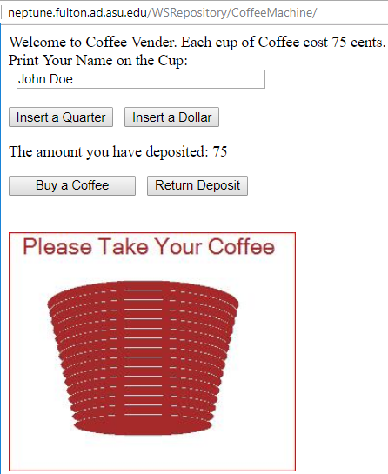
Finite State Machine Model
http://neptune.fulton.ad.asu.edu/WSRepository/CoffeeMachine/
soda
15
nickel
soda
soda
35
nickel
dime
nickel
20
30
dime
nickel
dime
dime
dime
5
10
nickel
nickel
40
45
nickel
nickel
nickel
dime
soda
dime
nickel
return
soda
0
quarter
25
quarter
50
return
return
quarter
If (Sum>75) Sum = Sum – 75
release soda
If Sum < 75, do nothing
soda
dollar
0
> 0
quarter
dollar
If (Sum== 75)
release soda
return
Sum = Sum + 25
Sum = Sum + 100

Slide 44
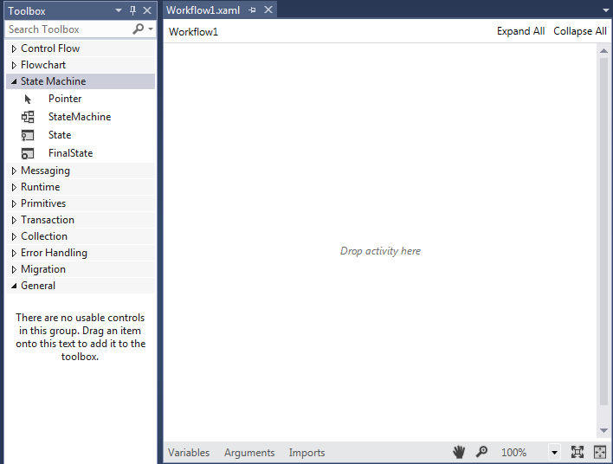
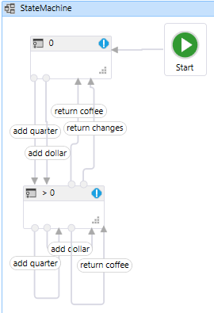
Implementing a State Machine

Slide 45
Event-Driven and State Machine for eBusiness Application
http://msdn.microsoft.com/en-us/magazine/cc163281.aspx
Submitted
An Ordering Process
Assigned
approve
Approved
Rejected
reassign
cancel
Ordered
Completed

Slide 46
State Machine of Ordering Process in Table View
State | Allowed Transitions
Submitted | Assigned
Assigned | Approved or Rejected
Approved | Ordered
Rejected | Assigned or Completed
Ordered | Completed
Completed | (None)

Slide 47
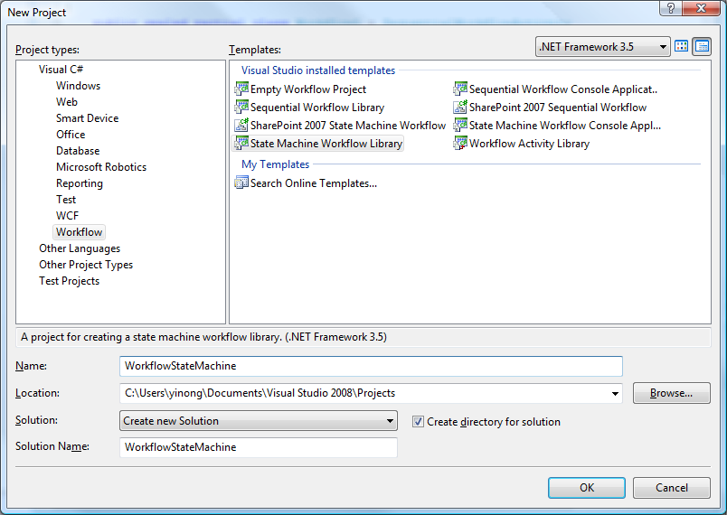
Using the State Machine Template

Slide 48
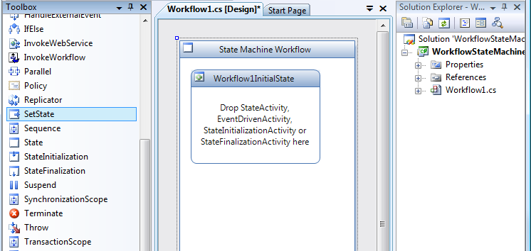
State Machine Template and Services

Slide 49
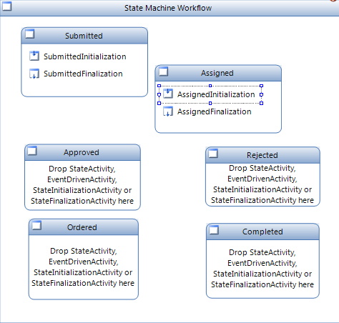
Define States
Submitted
Assigned
approve
Approved
Rejected
reassign
cancel
Ordered
Completed

Slide 50
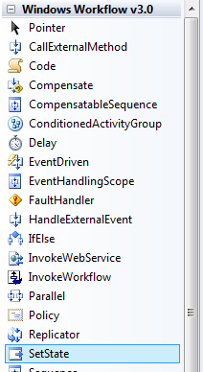
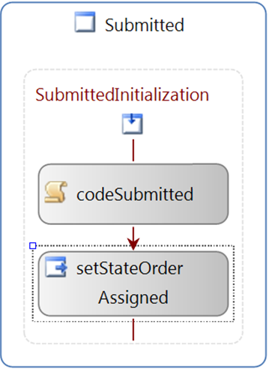
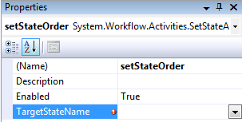

Connecting States Through Target State

Slide 51
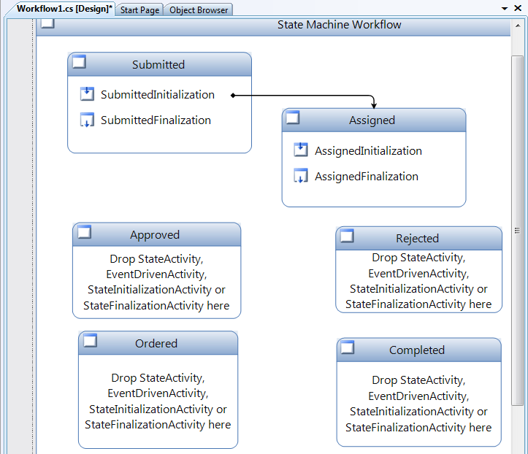
States are Connected

Slide 52
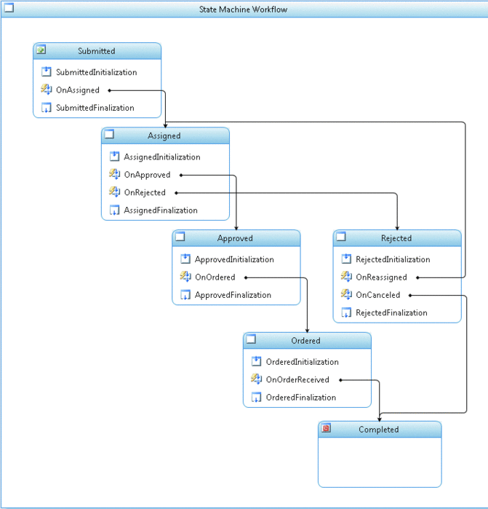
All Connected
Architecture-Drive Development
Submitted
Assigned
approve
Approved
Rejected
reassign
cancel
Ordered
Completed

Slide 53
Steps Implementing the Application Logic
Determine the events required for data exchange and state transitions.
Define an External Data Exchange interface.
Add EventDriven activities to the state machine workflow.
Reference the external data exchange interface.
Implement the External Data Exchange interface.
Add the External Data Exchange to the workflow runtime.
Use the External Data Exchange to exchange data and transition states.

Slide 54
Code Behind: Event Interfaces
namespace ExternalDataExchange
{
[ExternalDataExchange()] public interface IEventService
{
event EventHandler<SupplyFulfillmentArgs> Assigned;
event EventHandler<SupplyFulfillmentArgs> Approved;
event EventHandler<SupplyFulfillmentArgs> Rejected;
event EventHandler<SupplyFulfillmentArgs> Reassigned;
event EventHandler<SupplyFulfillmentArgs> Canceled;
event EventHandler<SupplyFulfillmentArgs> Ordered;
event EventHandler<SupplyFulfillmentArgs> OrderReceived;
}
}

Slide 55
Implementing the Event Interface
public void RaiseAssignedEvent(System.Guid instanceId, string assignedTo)
{ // Check to see if event is defined
if (this.Assigned != null)
{ // Create the EventArgs for this event
LocalService.SupplyFulfillmentArgs args = new
LocalService.SupplyFulfillmentArgs(instanceId);
args.AssignedTo = assignedTo;
// Raise the event
this.Assigned(this, args);
}
}

Slide 56
Summary the Lecture
Key Ideas of Workflow-based Application Development
WF Constructs and Activities
Creating WF workflow Application
Integrating WF and WCF
Creating WF Services
Event-Driven Approach and State Machine in WF
Workflow Supports
Architecture-Drive Development
Control flow and Dataflow
Synchronous and Asynchronous communications

